Slide 1
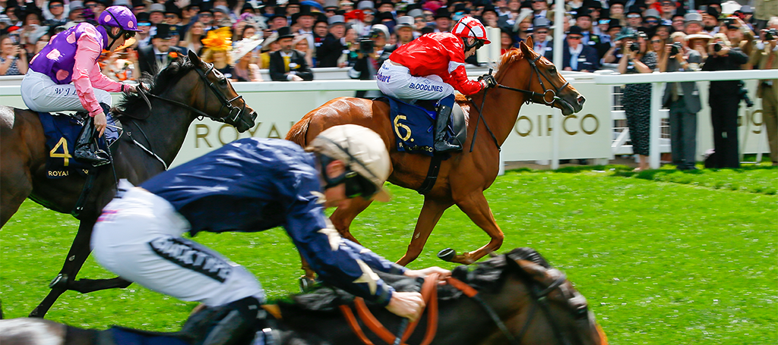

AN INDUSTRY
THREATS SOLUTIONS OPPORTUNITIES

Slide 2
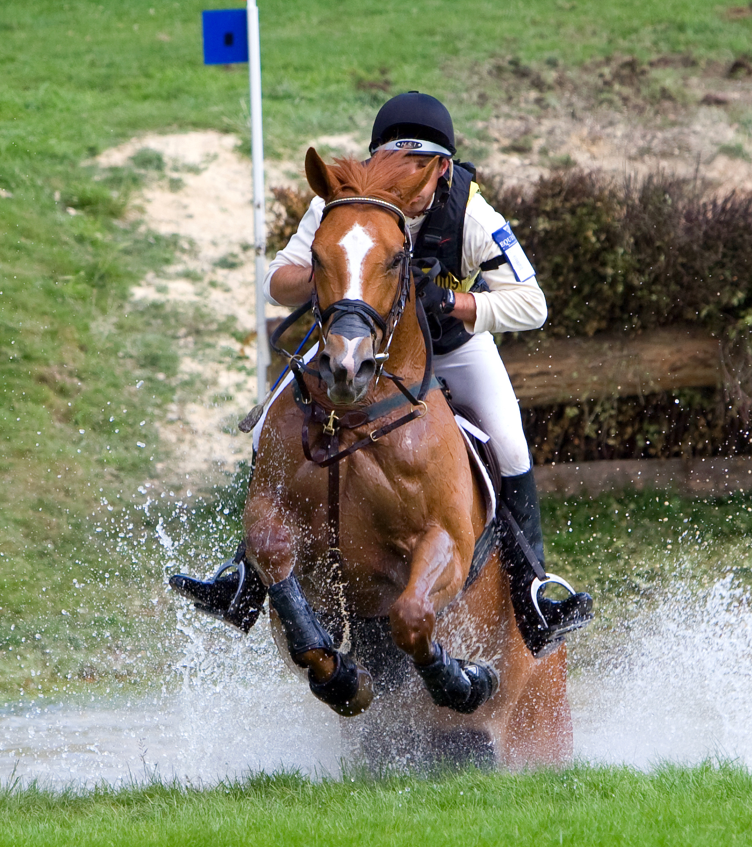
AN INDUSTRY
The EU equid sports and leisure market is the largest in the world
The EU’s 7 million equids use at least 2.6 million hectares of land
Environmentally friendly, non-intensive, primarily rural area activity

Slide 3
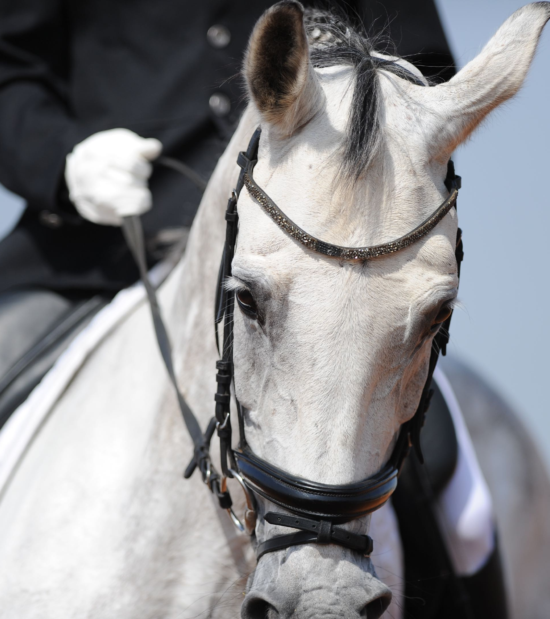
AN INDUSTRY
€52.1 billion per annum - The combined value of Sport horse / Equestrian, Racing and Breeding
€20.3 billion for horseracing – (excludes Betting tax income for Governments)
€31.8 billion for Sport Horses
EU member states receive €1.5 billion per annum in Betting taxes
210,000 direct full time jobs in racing and sports horses
500,000 direct and indirect jobs
(Verified Data from the ISHC Task Force – the first time the industry has been quantified)

Slide 4
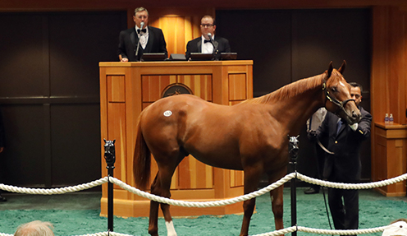
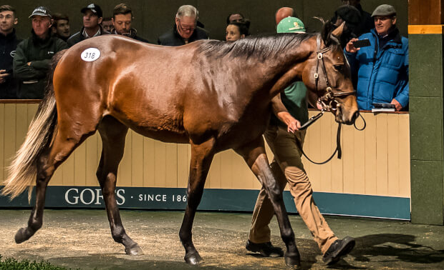
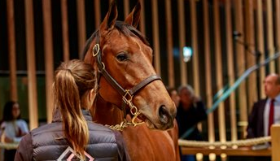
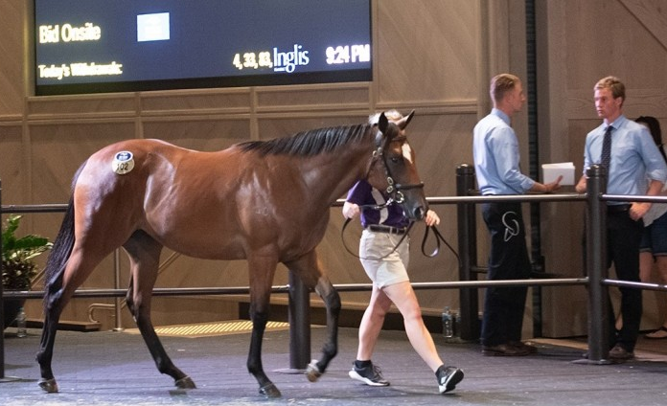
THOROUGHBRED RACING & BREEDING
ARE VERY SIGNIFICANT EU EXPORT EARNERS
EU EXPORTS TO THIRD COUNTRIES - THOROUGHBREDS SOLD AT PUBLIC AUCTION
North America (USA,Canada, Mexico etc)
South America (Brazil, Argentina, Chile etc)
Middle East (Saudi Arabia, Qatar, UAE, Kuwait, Turkey, Bahrain etc)
Far East (China, Hong Kong, Macau, etc)
Pacific Rim (Australia, New Zealand, Singapore, Malaysia, India, Sri Lanka, etc)
Africa (South Africa, Morocco, Libya, Namibia etc)
Northern / Eastern Europe (Non EU – Norway, Russia, Georgia etc)
TOTAL Exports to Third Countries will rise to €3 Billion when UK becomes 3rd Country post BREXIT
TOTAL €1,483,000,000

Slide 5
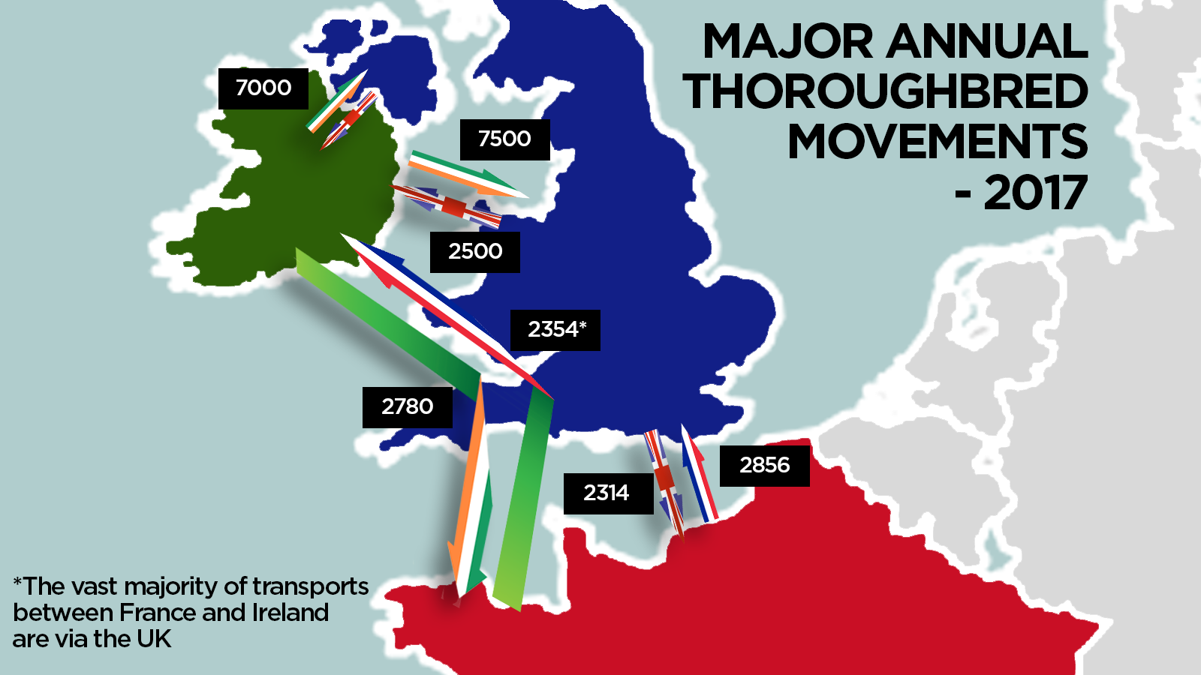
THREATS
More Thoroughbreds move between FR, IRL and UK than anywhere else in the world
20,892 Thoroughbreds were transported between France, Ireland and Britain in 2017 (not including 7,000 movements between Republic of Ireland and Northern Ireland)
423 major FEI events and shows in Europe in 2019, in 29 European and EU Countries with 425,264 horse entries.
This free movement of elite horses has been facilitated by the Tri-partite Agreement (FR, IRL and UK) for more than 40 years

Slide 6
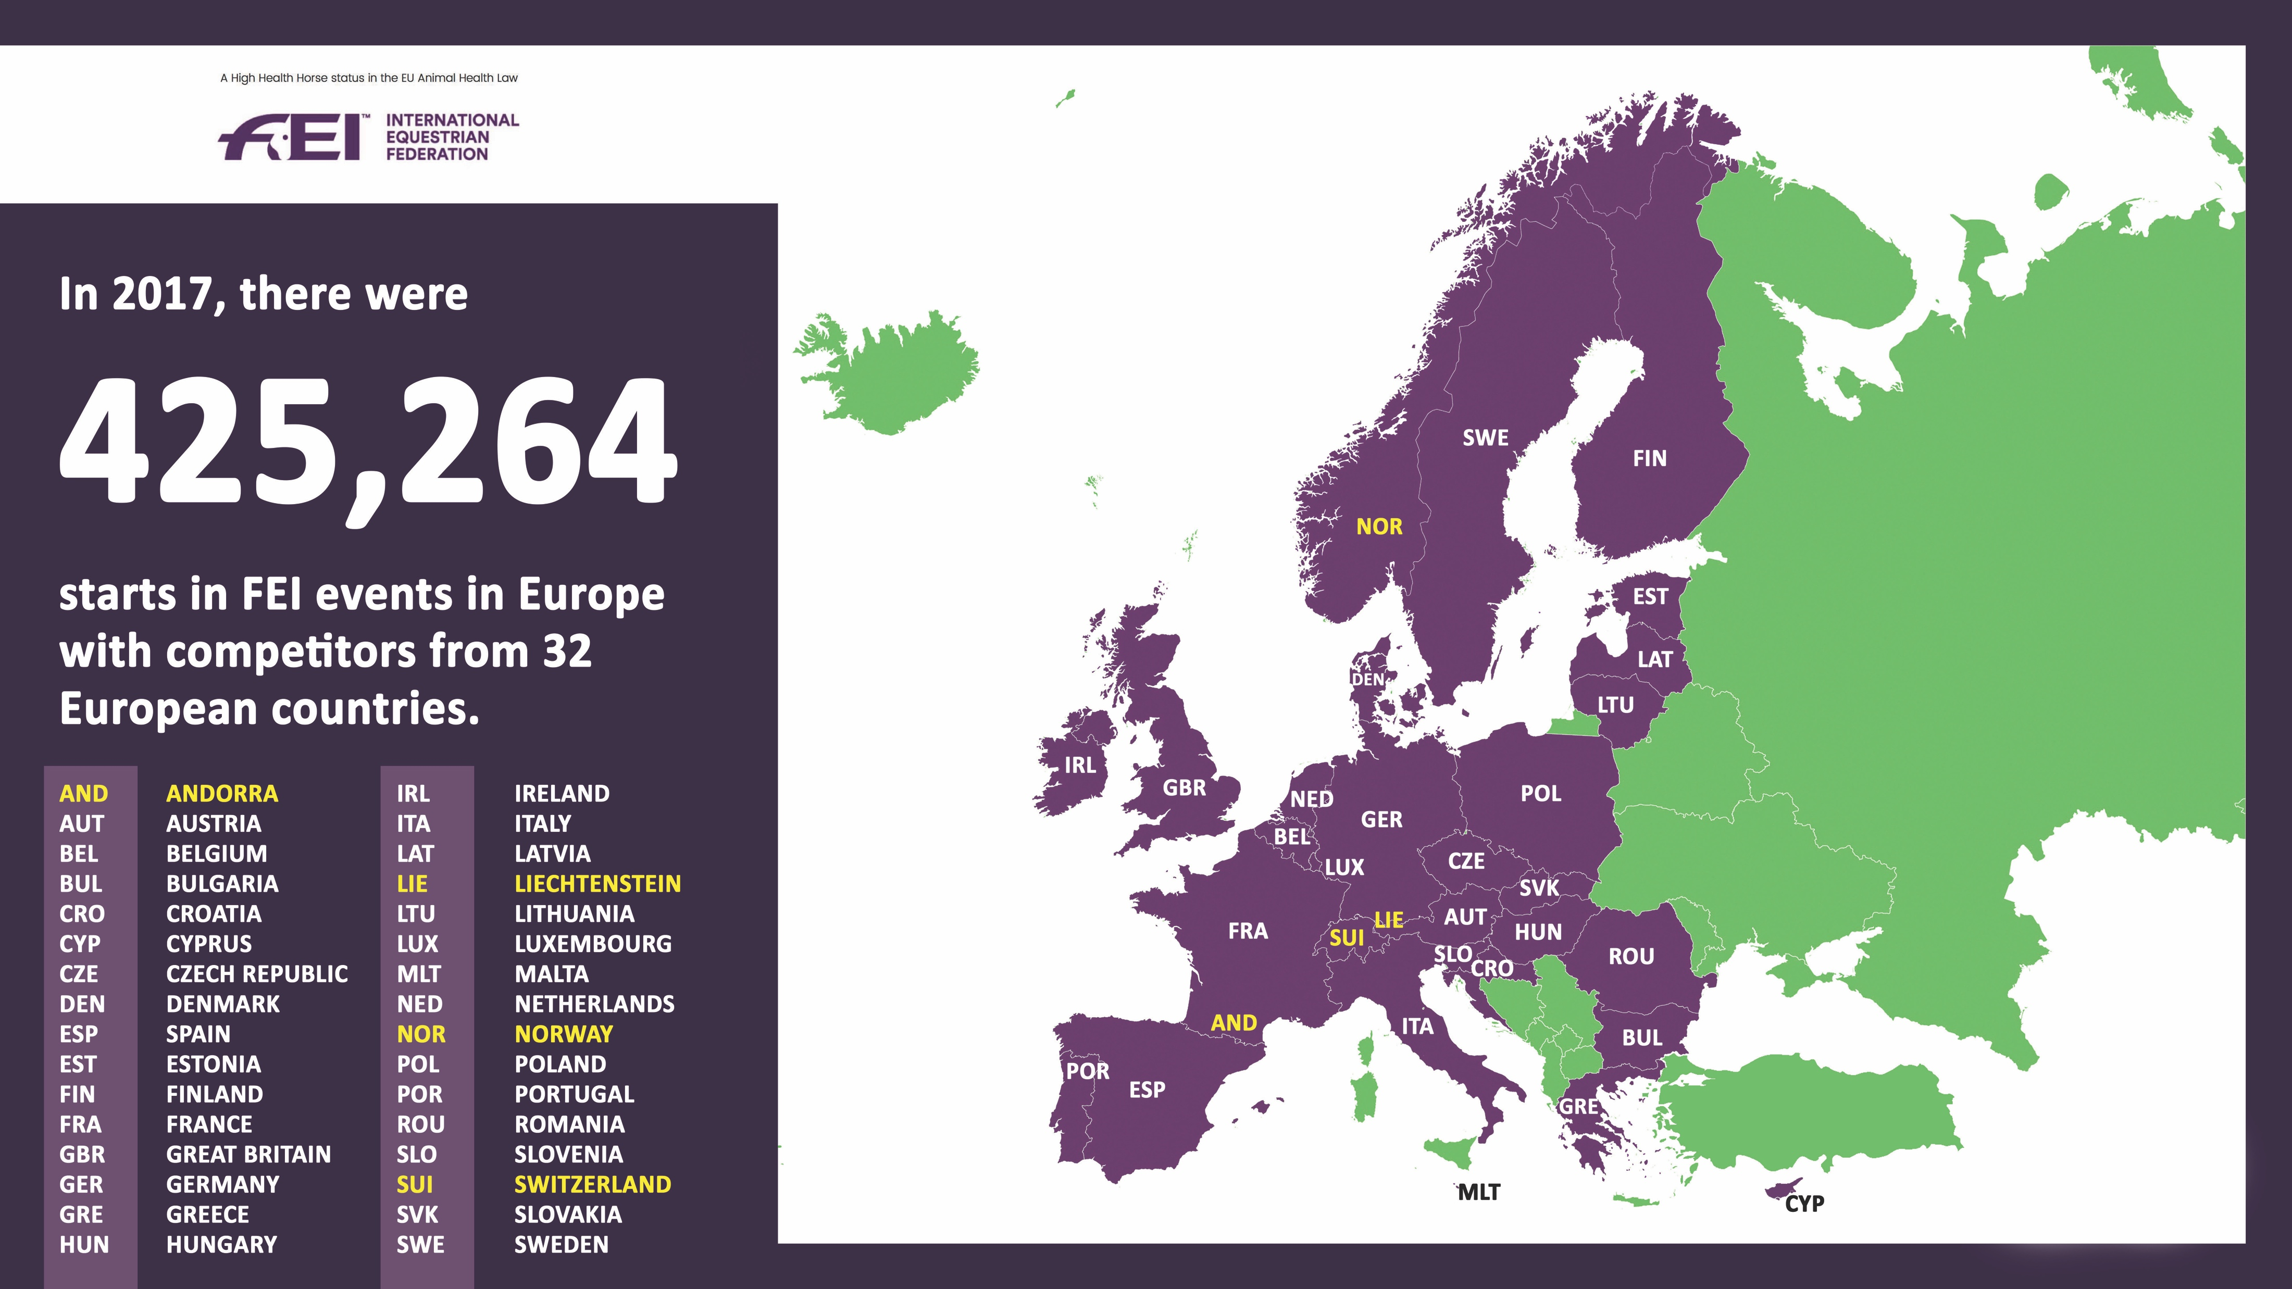

Slide 7
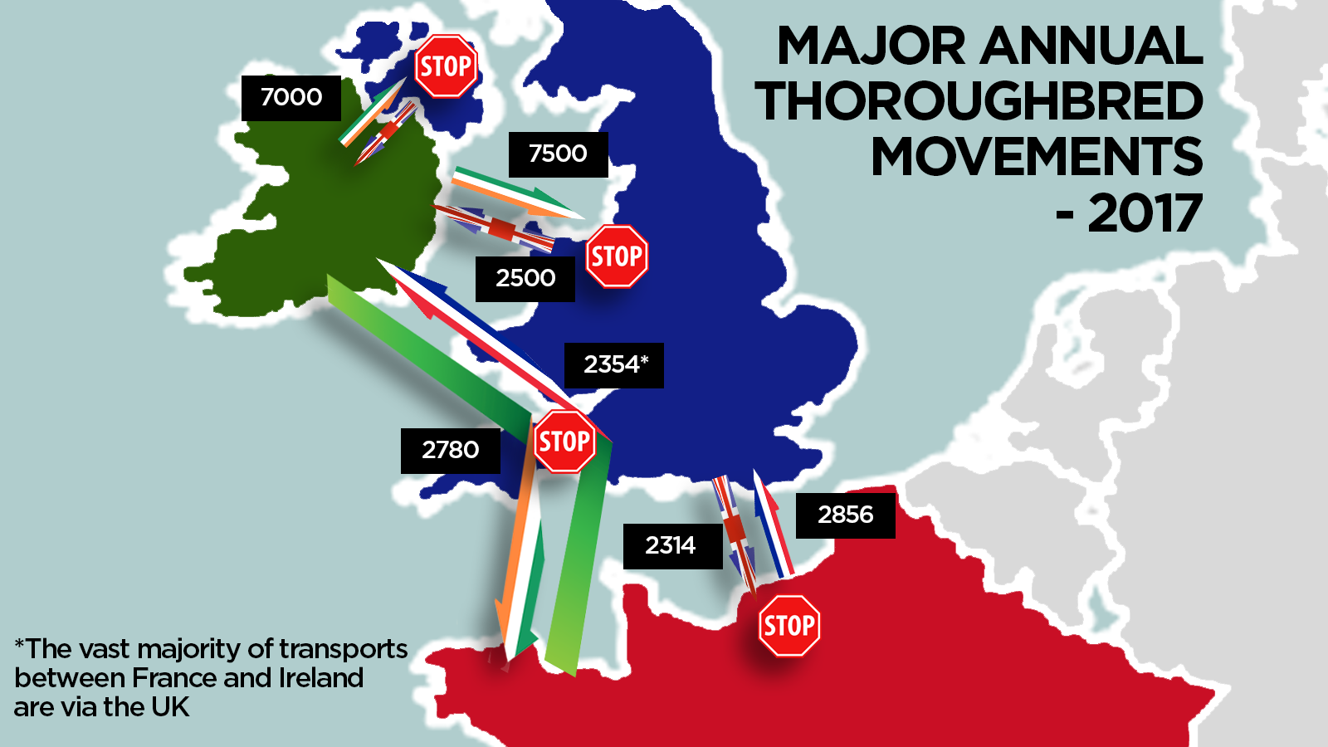
THREATS
The post-Brexit Transition ends in December 2020 and with it, the TPA also ends
If there is no Free Trade Agreement there will be very significant and damaging disruption of this vital free movement
The 2021 new EU Animal Health Law will also restrict the previous freedom of movement

Slide 8
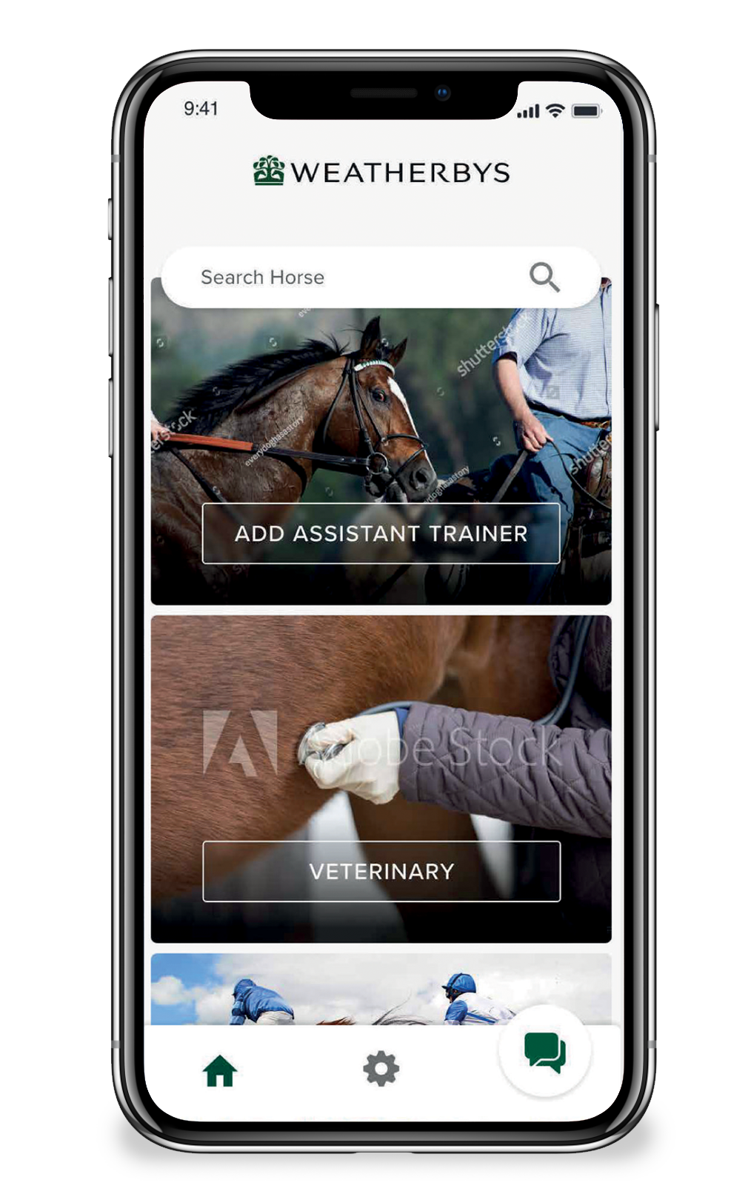
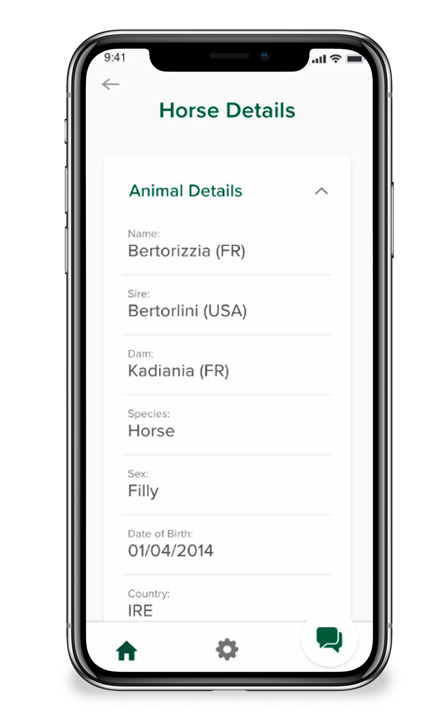
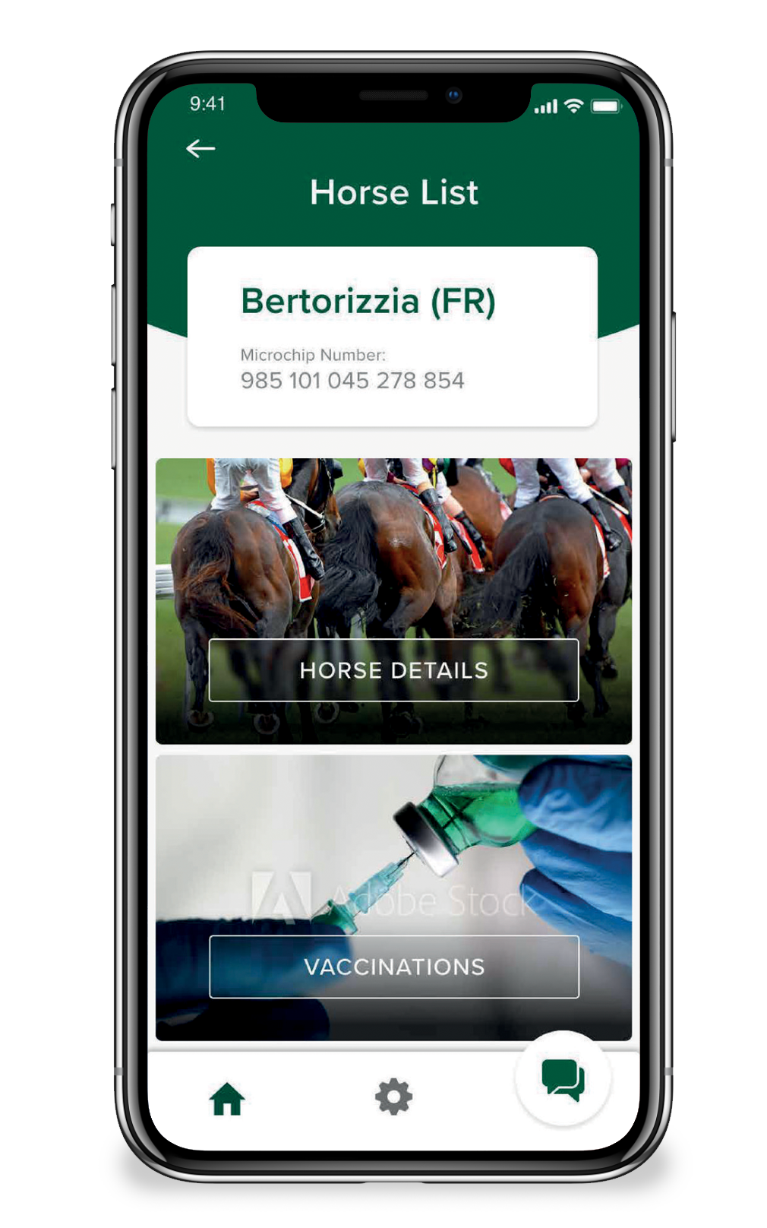
SOLUTION
DIGITAL PASSPORT FACILITATED MOVEMENT OF HIGH HEALTH STATUS HORSES

Slide 9
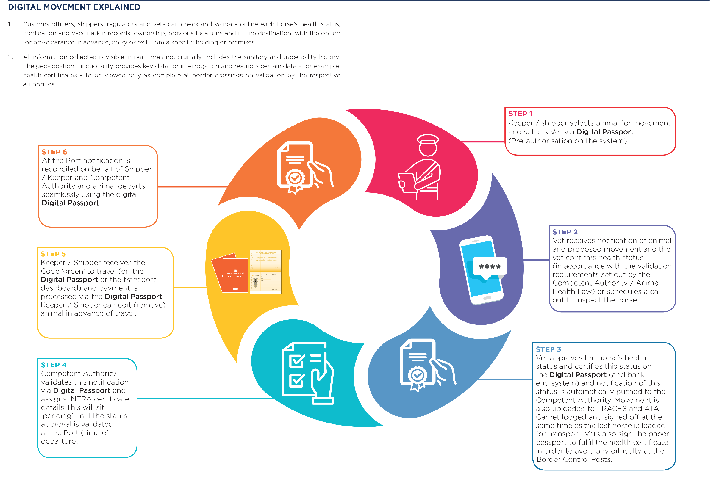
SOLUTION
DIGITAL PASSPORT FACILITATED MOVEMENT OF HIGH HEALTH STATUS HORSES
Collective data share, integration and health accreditation are fundamental to maintaining ‘Free movement’
Expedited movement is essential for racing, competition and for breeding, in particular Thoroughbred breeding where the use of natural service is obligatory under international agreement

Slide 10

OPPORTUNITIES
DIGITAL PASSPORT
Lifetime document – ID, Movement, Vaccination & Medication (includes Disease Test Records (CEM, EVA, EIA), Ownership (includes change of ownership facility)
Movement & Vaccination already in use. Fully operational from beginning of 2021. Paper passport issued alongside Digital Passport as required EU Law
Can preserve current freedom of movement and health standards
Removes the need for new requirements and any need for further checks at Ports of Entry

